Slide 1
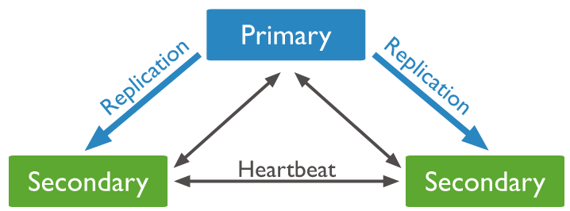
Election for Primary - Replica Set Elections

